Slide 1
Design and Analysis of Algorithms
Growth of Functions(Ch3)
Software School of XiDian University

Slide 2
Design and Analysis of Algorithms
Growth of functions
Topics:
Growth of functions
O/Θ/Ω notations
Software School of XiDian University

Slide 3
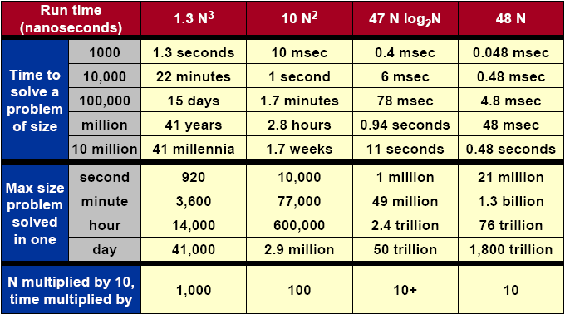
What Does It Matter?
Software School of XiDian University

Slide 4
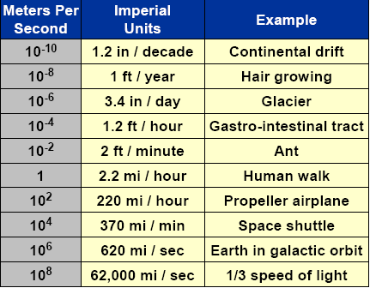
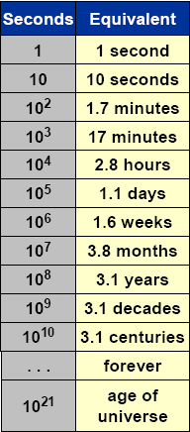

Orders of Magnitude
Software School of XiDian University
Notes:
Glacier：冰河
gastro-intestinal：胃肠，tract：组织
Propeller：推进者, 推进物, 尤指轮船, 飞机上的螺旋推进器
Shuttle： 航天飞机
Galactic：银河的，极大的

Slide 5
Asymptotic Growth
In the insertion-sort example we discussed that when analyzing algorithms we are
--interested in worst-case running time as function of input size n.
--not interested in exact constants in bound.
--not interested in lower order terms
A good reason for not caring about constants and lower order terms is that the RAM model is not completely realistic anyway (not all operations cost the same).
Software School of XiDian University

Slide 6
Asymptotic Growth
We want to express rate of growth of standard functions:
--the leading term with respect to n.
--ignoring constants in front of it
>>k₁n + k₂ ~ n
>>k₂nlogn ~ nlogn
>>k₁n² + k₂n + k₃ ~ n²
We also want to formalize e.g. that a n log n algorithms is better than a n² algorithm.
O-notation (Big-O)
--you have probably all seen it intuitively done but we will now done it more carefully.
Software School of XiDian University

Slide 7
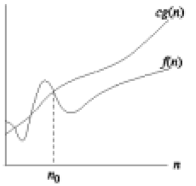
O-notation
O(g(n)) = {f(n): There exist positive constants c and n₀ such that 0≤f(n) ≤cg(n) for all n≥n₀}
--O(.) is used to asymptotically upper bound a function.
--O(.) is used to bound worst-case running time.
Software School of XiDian University

Slide 8
O-notation
Examples:
--1/3n² – 3n ∈O(n²) because 1/3n² – 3n ≤cn² if c≥1/3-3/n which holds for c = 1/3 and n >1
--k₁n²+k₂n+k₃∈O(n²) because k₁n² + k₂n+ k₃≤(k₁+|k₂|+|k₃|)n² and for c > k₁ + |k₂| + |k₃| and n≥ 1, k₁n² + k₂n + k₃ ≤ cn²
--k₁n²+k₂n+k₃∈O(n³) as k₁n² + k₂n+ k₃≤(k₁+|k₂|+|k₃|)n³ (upper bound)
Software School of XiDian University

Slide 9
O-notation
Note:
--When we say “the running time is O(n²)” we mean that the worst-case running time is O(n²) – the best case might be better.
--Use of O-notation often makes it much easier to analyze algorithms; we can easily prove the O(n²) insertion-sort time bound.
--We often abuse the notation a little:
>> We often write f(n) = O(g(n)) instead of f(n) ∈O(g(n))
>> We often use O(n) in equations: e.g. 2n² + 3n + 1 = 2n² + O(n) (meaning that 2n² + 3n + 1=2n² + f(n) where f(n) is some function in O(n))
>>We use O(1) to denote constant time.
Software School of XiDian University

Slide 10
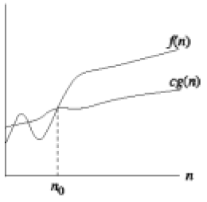
Ω-notation
Ω(g(n)) = {f(n): There exist positive constants c and n₀ such that 0 ≤ cg(n) ≤f(n) for all n≥n₀}
--We use Ω-notation to give a lower bound on a function.
Software School of XiDian University

Slide 11
Ω-notation
Examples:
--1/3n² – 3n ∈Ω(n²) because 1/3n² – 3n ≥cn² if c≤1/3-3/n which holds for c = 1/6 and n >18
--k₁n²+k₂n+k₃∈Ω(n²)
--k₁n²+k₂n+k₃∈Ω(n) (lower bound)
Software School of XiDian University
Notes:
1/3

Slide 12
Ω-notation
Note:
--when we say “the running time is Ω(n²)” we mean that the best-case running time is Ω(n²) – the worst case might be worse.
--Insertion-sort:
>> Best case: Ω(n) – when the input array is already sorted.
>> Worst case: O(n²)– when the input array is reverse sorted.
>>We can also say that the worst case running time is Ω(n²)
Software School of XiDian University

Slide 13
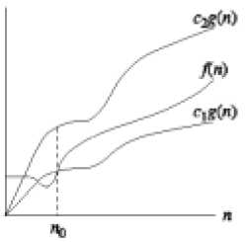
Θ-notation
Θ(g(n)) = {f(n): There exist positive constants c₁, c₂ and n₀ such that 0 ≤ c₁g(n) ≤f(n) ≤c₂g(n) for all n≥n₀}
--We use Θ-notation to give a tight bound on a function.
-- f(n) =Θ(g(n)) if and only if f(n) = O(g(n)) and f(n) = Ω(g(n))
Software School of XiDian University

Slide 14
Θ-notation
Examples:
-- k₁n²+k₂n+k₃∈Θ(n²)
--The worst case running time of insertion-sort is Θ(n²)
--6nlgn + √nlg²n=Θ(nlgn)
>>We need to find c₁, c₂, n₀ > 0 such that c₁nlgn ≤ 6nlgn + √nlg²n ≤ c₂nlgn for n≥ n₀.
>> c₁nlgn ≤ 6nlgn + √nlg²n → c₁ ≤ 6 + lgn/√n, which is true if we choose c₁ = 6 and n₀ = 1. 6nlgn + √nlg²n ≤ c₂nlgn → 6 + lgn/√n ≤ c₂, which is true if we choose c₂ = 7 and n₀ = 2. This is because lgn ≤√n if n ≥2. So c₁ = 6, c₂ = 7 and n₀ = 2 works.
Software School of XiDian University

Slide 15
Θ-notation
Note:
--We often think of f(n) = O(g(n)) as corresponding to f(n)≤g(n).
--Similarly, f(n) = Θ(g(n)) corresponds to f(n) = g(n)
--Similarly, f(n) = Ω(g(n)) corresponds to f(n) ≥ g(n)
Software School of XiDian University

Slide 16
Asymptotic Notation in Equations
Used to replace functions of lower-order terms to simplify equations/expressions.
For example,
4n³ + 3n² + 2n + 1 = 4n³ + 3n² + Θ(n)
= 4n³ + Θ(n²) = Θ(n³)
Or we can do the following: 4n³ + 3n² + 2n + 1 = 4n³ + f(n²)
Where f(n²) simplifies the equation
Software School of XiDian University

Slide 17
Simple Review
Merge Sort
  MERGE-SORT(A,p,r)
  MERGE(A,p,q,r)
Analysis of Merge Sort－Θ(nlgn), by
  Picture of Recursion Tree
  Telescoping
  Mathematical Induction
Asymptotic Growth
  O-notation
Software School of XiDian University

